Slide 1
Functional form
If onset is included in this equation, what’s the difference from:
Planting date = fcn(onset, etc)? Theoretically would just be getting a slope for onset that’s different by 1 unit
f (climate constraints and farmer chars)
(Planting date – onset date)
Explanatory variables:
Temperature (probably only matters in the South where frost and photoperiod control planting, ignore for other areas? Test if it’s ignorable by comparing results with random forest. If can’t ignore, do some sort of anomalous accumulation for temperature?)
Onset (nonlinear, maybe piecewise, definitely changes with region)
Latitude (should be just an intercept)
Memory of previous years’ planting
Neighbors
Irrigation
Trend
Size of farm
Average onset over 30 years
Variance in onset over 30 years
Fixed effects for pockets of space and time (credit, equipment, laws)
Interaction variables:
Climate x size
Climate x irrigation
It’s okay to do plant = fcn (onset). Perhaps test other definitions of onset, e.g. the date at which some threshold of total rain since Aug 1, or the date at which a storm of a certain depth is reached. Test different ‘other onset definitions’ against anomalous accumulation onset by doing a regression or scatterplot. We know that onset matters – but maybe test out another date.
Notes:
Question 1 can have onset as explanatory variable. It’s descriptive. (we hypothesize onset date guides planting date here. Is that a good assumption for most parts of Brazil?)
Question 2 can’t have onset as explanatory variable because growers can’t observe it. It’s a model of behavior.
Have separate models for single and double cropping?
Are growers old or young? Big or small farm? ‘grower fixed effects’ (conditional on a certain type of grower). Assume it’s the same grower over short time period. What happens when you control for farmer characteristics?
Map shows when soy is visible to satellites, not exactly soy planting. Could have crop failure or replanting. It’s not a perfect measure of decision to plant. Model of planting date decision + something else. Focus on variables that will change and that we know how they will change.

Slide 2
‘Decision to plant” vs “plants seen by satellite”
RS indicator of planting
Planting decision
VI timeseries
Calibration error: use Matopiba to characterize the peak/infl -> plant/harvest with cross validation.
Effect of ‘wetness’ of planting time
Effect of temperature during planting time
For the fact that some crops fail: report the percent of farmers who say their crop failed in Matopiba survey. Look at pixels in a polygon that were bare soil or weeds for the entire growing season for an estimate of crop failture. Claim that we are only seeing a certain percent of the planting outcome with our RS method; only the successful crop.
If we claim to look at ‘planting decision’, also need to account for failed crops
Report as source of error from Matopiba, or
Only claim to do a model of successful soy

Slide 3
Subsets | OLS model selection (demeaned) | FE for each CAR poly | FE for each state | Random forest
All Brazil, all years | Within each subset, choose best combo of vars using: Forward and backward model selection with adjusted R2, p-value Residuals (random? Homoscedastic? Autocorrelated?) Multicollinearity (take one out, see if other coeffs change) – see if each indiv vars are collinear w/ each other Test nonlinear transforms of variables and interaction terms |  |  | Add in ‘dummy vars’ representing each subset Add in T, P (weekly or daily) variables to see if they improve predictions. If so, use random forest alone; if not, ignore them
Five major regions (based on political bounds, ‘soy spots’), all years
200km cells, all years
50km cells, all years
Five major regions, groups of 3 years (ignore trend)
Five major regions, each indiv year (ignore trend)
Can do a time trend, won’t really hurt
To test predictive ability (and therefore compare OLS vs FE), make sure the new year contains climate that was trained. Can try predictive ability in dry, wet, 50th percentile year, etc.
Subsetting: how do you know what spatial scale creates ‘stability’? look at different scales, plot the coefficient on the y axis and scale on x axis, look at whether there’s a flat part in the curve. If pick a scale, e.g. 50k, do regression for 40km and 60km as well to see whether the coefficients are the same, as a robustness check. Do subsetting hierarchically – within each state, divide into 200km cells, then divide the 200km cells into 50km cells.
Model evaluation/model selection within each model specification
For OLS and FE, choose the largest subset that causes coefficients to stabilize, R2 (hierarchical)
Robustness check: small rescaling after finding ‘best’ scale (50km -> 60, 40 km)
Model selection to compare OLS vs FE
Cross-validation
Test predictive ability (in most recent year, e.g.) – check that the new year contains the climate that was trained; try predictive ability for dry, wet years, etc.
To cope with the fact that response to onset is nonlinear: first do plant = fcn(T, size, etc) and get residuals. Then plot residuals on y axis and onset on x axis and see if onset is linear or not. Can also use separate models for early vs late onset but need to define when the threshold is for late onset (sensitivity test)

Slide 4
Model diagnostics
Choosing among models | Training | Testing | Notes
Cross validation | All polygons except for one | The polygon that’s missing, given actual weather; repeat and average errors. Report errors for categories (i.e. region, irrig/not irrig, large/small) | ‘how well does the model describe the past?’
Validation for ‘future predictions’ | All years except one | All polygons in the missing year | ‘how well does the model predict future planting for the same farmer?’
Validation for ‘prediction in new soy area’ | all polygons in a certain area | Polygons in another area | Probably won’t work. Won’t have the memory term, and memory is probably a strong expl var. ‘how well does the model predict future planting for a new soy field?’
Choosing within OLS and FE regression:
Everything for choosing among models
Adjusted R2
‘ease of use’ (i.e. lots of regions to choose from?)

Slide 5
Do farmers actually plant before onset?
Single Cropping
% of soy area planted before onset | Mato Grosso | Matopiba | Central | Mato Grosso do Sul, Sao Paulo | South
2003 | 0.04 | 0.05 | 0.2 | 0 | 0
2004 | 0.4 | 0.8 | 0.2 | 0.05 | 0
2005 | 0.09 | 0.2 | 0.5 | 0 | 0
2006 | 0.07 | 0.02 | 0.02 | 0.1 | 0
2007 | 1.8 | 3.6 | 5 | 0.9 | 0
2008 | 0.9 | 0.1 | 0.4 | 0.1 | 0
2009 | 0.08 | 0.06 | 0 | 0 | 0
2010 | 4.6 | 0.1 | 1 | 0.05 | 0.2
2011 | 0.04 | 0.03 | 0.1 | 0.17 | 1
2012 | 1 | 0.9 | 6.4 | 0.18 | 0
2013 | 1.1 | 0.36 | 4.2 | 0.05 | 0
2014 | 8.9 | 1.9 | 8.2 | 0.2 | 0

Slide 6
Do farmers actually plant before onset?
Double Cropping
% of soy area planted before onset | Mato Grosso | Matopiba | Central
2003 | 0.04 | 0.01 | 0.4
2004 | 0.15 | 1.2 | 0.4
2005 | 0.015 | 0.3 | 0.6
2006 | 0.05 | 0.04 | 0.04
2007 | 2.8 | 7.9 | 8.7
2008 | 2.4 | 0.1 | 0.6
2009 | 2.7 | 0.05 | 0
2010 | 13.4 | 0.2 | 1.7
2011 | 0.03 | 0.05 | 0.1
2012 | 1.6 | 3 | 16
2013 | 1.5 | 0.5 | 1.3
2014 | 15.6 | 2.3 | 7.4

Slide 7
Single Cropping
Planting date stays constant while onset changes. This creates a strong delay vs. onset trend (due to onset changing but planting date not changing)
% of soy area planted before onset | Mato Grosso Onset (mean) | Mato Grosso delay (median) | Mato Grosso plant (median)
2003 | 53 | 64 | 42
2004 | 61 | 50 | 45
2005 | 57 | 58 | 44
2006 | 49 | 46 | 49
2007 | 68 | 26 | 48
2008 | 66 | 47 | 45
2009 | 42 | 70 | 45
2010 | 67 | 25 | 47
2011 | 62 | 49 | 45
2012 | 56 | 43 | 44
2013 | 61 | 30 | 46
2014 | 71 | 14 | 46

Slide 8
Double Cropping
Planting date stays constant while onset changes. This creates a strong delay vs. onset trend (due to onset changing but planting date not changing)
% of soy area planted before onset | Mato Grosso Onset (mean) | Mato Grosso delay (median) | Mato Grosso plant (median)
2003 | 53 | 61 | 42
2004 | 61 | 40 | 47
2005 | 57 | 56 | 45
2006 | 49 | 41 | 48
2007 | 68 | 22 | 50
2008 | 66 | 43 | 45
2009 | 42 | 65 | 46
2010 | 67 | 19 | 48
2011 | 62 | 46 | 45
2012 | 56 | 40 | 43
2013 | 61 | 25 | 45
2014 | 71 | 12 | 44

Slide 9
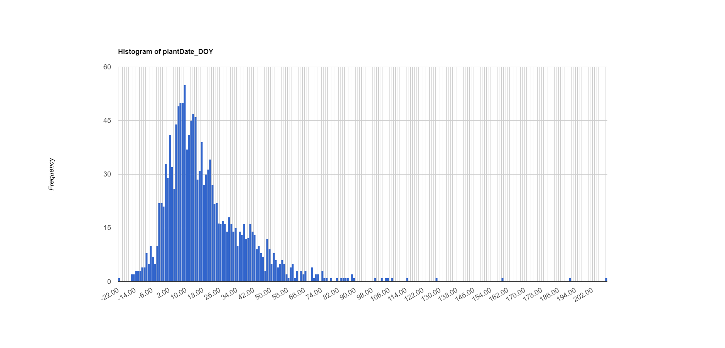
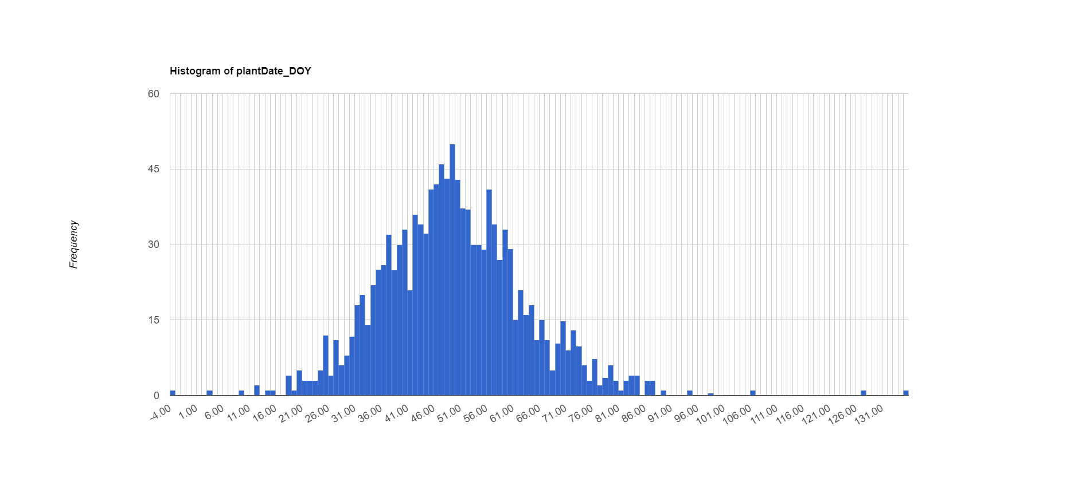
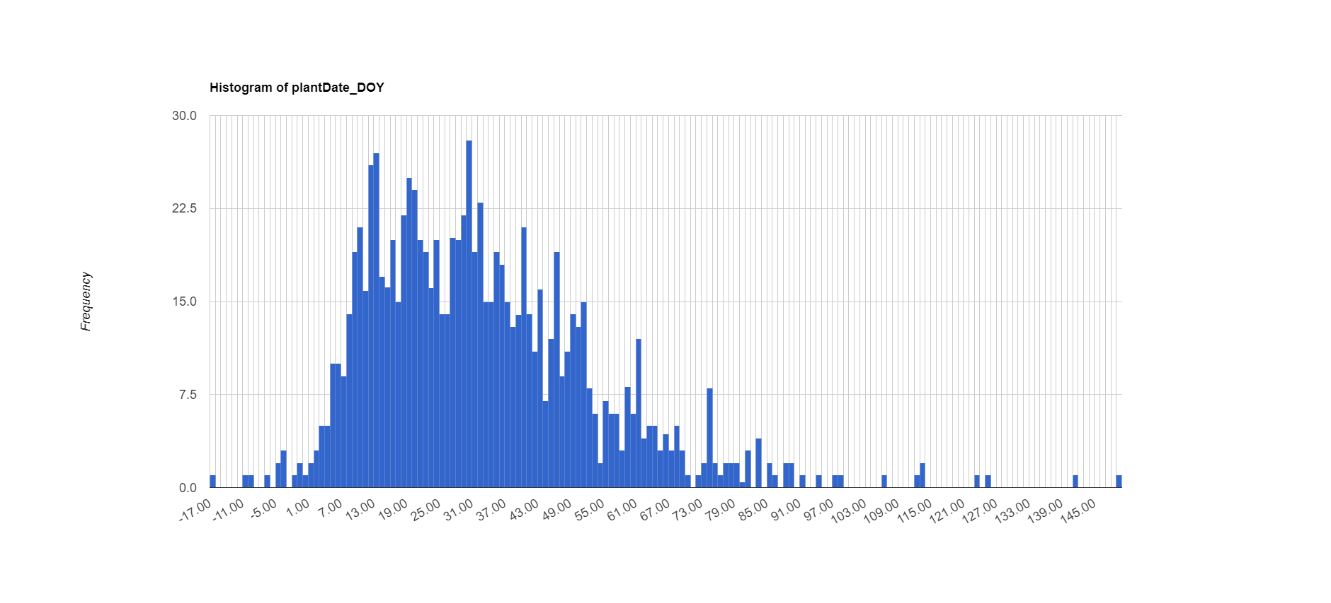
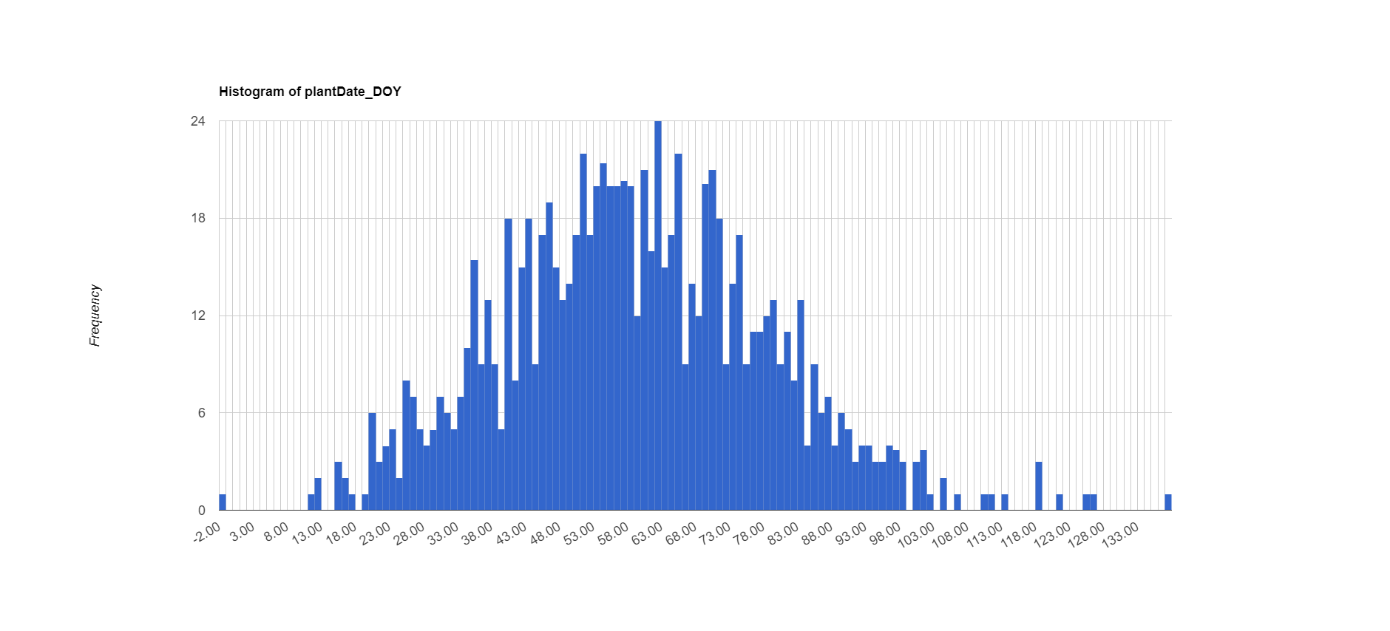
Single Cropping
In Mato Grosso, when onset is late, delay pdf becomes very right skewed even though when onset is earlier, delay pdf is normal. Indicates that farmers are actually good at planting after onset. Here are pdfs of delay in Mato Grosso:
Late onset, delay slams to zero
Early onset, delay is normally distributed
Other areas plant at least a month after onset and so aren’t sensitive at all to changes in onset.

Slide 10
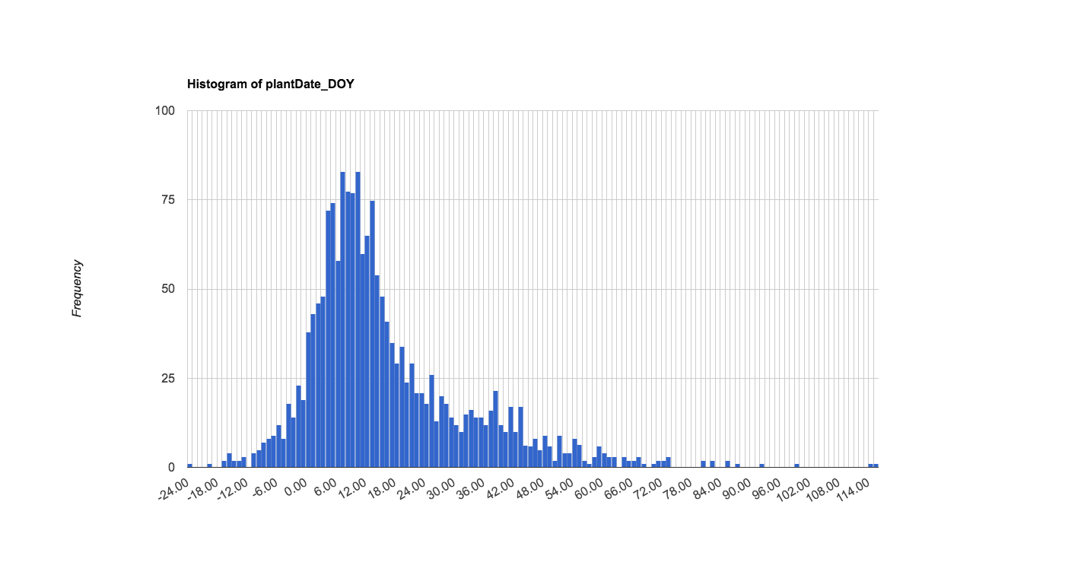
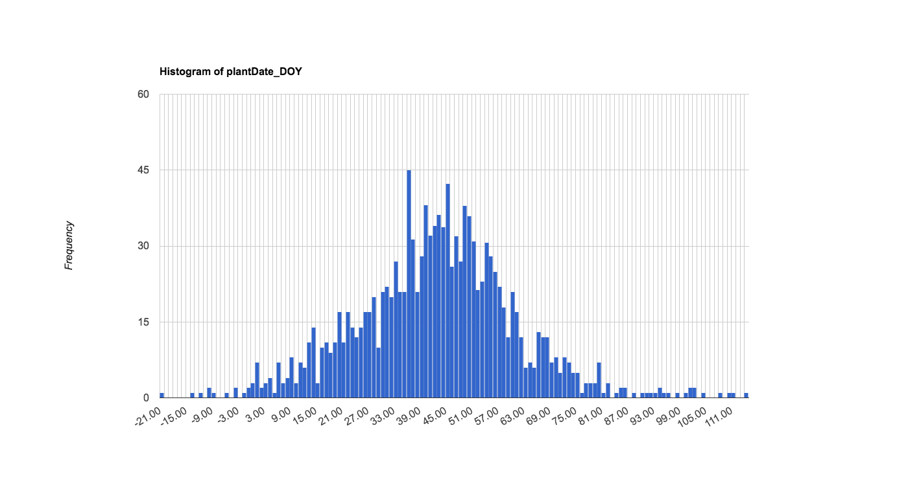
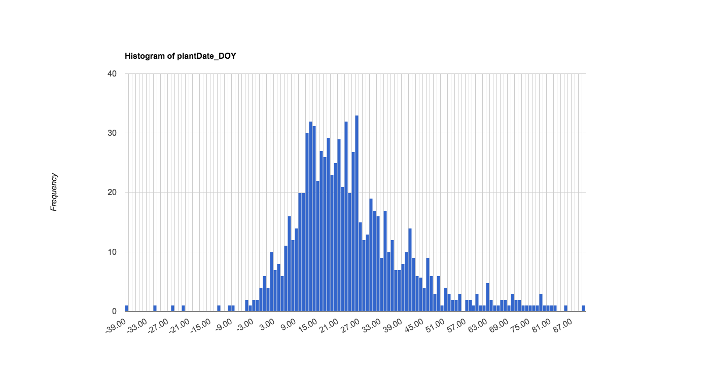
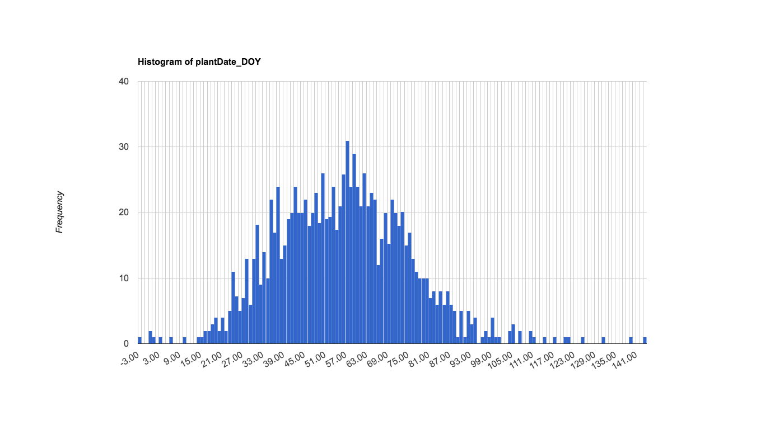
Double Cropping for Mato Grosso
Late onset
Early onset

Slide 11
Single Cropping
Irrigated areas are disproportionately represented in ‘negative delay’
In Mato Grosso, 28% of irrigated areas plant before onset in 2014
In Matopiba, 11% of irrigated areas plant before onset in 2014
In Central, 20% of irrigated areas plant before onset in 2014
In Mato Grosso, the fraction of ‘negative delay’ that’s irrigation is 2.6%
In Matopiba, the fraction of ‘negative delay’ that’s irrigation is 18%
In Central, the fraction of ‘negative delay’ that’s irrigation is 24%
If they plant before onset, they usually plant within 10 days of onset
In Mato Grosso, the fraction of ‘negative delay’ that’s within 5 days of onset is 50%
In Matopiba, the fraction of ‘negative delay’ that’s within 5 days of onset is 52%
In Central, the fraction of ‘negative delay’ that’s within 5 days of onset is 52%
In Mato Grosso, the fraction of ‘negative delay’ that’s within 10 days of onset is 76%
In Matopiba, the fraction of ‘negative delay’ that’s within 10 days of onset is 78%
In Central, the fraction of ‘negative delay’ that’s within 10 days of onset is 78%

Slide 12
Double Cropping
Irrigated areas are disproportionately represented in ‘negative delay’
In Mato Grosso, the fraction of ‘negative delay’ that’s irrigation is 3.1%
In Matopiba, the fraction of ‘negative delay’ that’s irrigation is 19%
In Central, the fraction of ‘negative delay’ that’s irrigation is 23%
If they plant before onset, they usually plant within 10 days of onset
In Mato Grosso, the fraction of ‘negative delay’ that’s within 10 days of onset is 80%
In Matopiba, the fraction of ‘negative delay’ that’s within 10 days of onset is 80 %
In Central, the fraction of ‘negative delay’ that’s within 10 days of onset is 82%

Slide 13
Single Cropping
% of soy area planted before onset | Matopiba Onset (mean) | Matopiba delay (median) | Matopiba plant (median)
2003 | 94 | 49 | 41
2004 | 94 | 53 | 41
2005 | 100 | 45 | 43
2006 | 77 | 72 | 46
2007 | 107 | 26 | 41
2008 | 99 | 43 | 45
2009 | 72 | 71 | 43
2010 | 83 | 53 | 42
2011 | 76 | 68 | 42
2012 | 98 | 40 | 42
2013 | 85 | 59 | 41
2014 | 89 | 46 | 43

Slide 14
Single Cropping
% of soy area planted before onset | Central Onset (mean) | Central delay (median) | Central plant (median)
2003 | 76 | 54 | 42
2004 | 74 | 54 | 41
2005 | 76 | 51 | 42
2006 | 53 | 74 | 46
2007 | 83 | 17 | 48
2008 | 73 | 46 | 43
2009 | 37 | 82 | 43
2010 | 59 | 40 | 45
2011 | 63 | 43 | 47
2012 | 74 | 30 | 44
2013 | 59 | 56 | 43
2014 | 78 | 17 | 46

Slide 15
Single Cropping
% of soy area planted before onset | MTDS and SP Onset (mean) | MTDS and SP delay (median) | MTDS and SP plant (median)
2003 | 53 | 78 | 40
2004 | 65 | 55 | 40
2005 | 44 | 83 | 40
2006 | 35 | 87 | 41
2007 | 77 | 35 | 42
2008 | 54 | 85 | 41
2009 | 17 | 110 | 39
2010 | 53 | 56 | 37
2011 | 61 | 48 | 43
2012 | 55 | 51 | 43
2013 | 52 | 52 | 42
2014 | 51 | 56 | 40

Slide 16
Single Cropping
% of soy area planted before onset | South Onset (mean) | South delay (median) | South plant (median)
2003 | 41 | 97 | 41
2004 | 37 | 100 | 38
2005 | 14 | 102 | 39
2006 | 16 | 128 | 37
2007 | 35 | 80 | 39
2008 | 13 | 122 | 41
2009 | 12 | 137 | 40
2010 | 49 | 99 | 38
2011 | 48 | 123 | 39
2012 | 36 | 78 | 40
2013 | 17 | 107 | 40
2014 | 24 | 102 | 38

Slide 18
What might control planting date?
Legal Constraints
Economic + Logistic Constraints
Phytosanitary law
Credit available?
Equipment available?
Consider physical constraints
wait
wait
wait
Physical Constraints
wait
Irrigation?
Frost?
Appropriate photoperiod?
plant
wait
Rains are ‘staying’?
Favorable forecast?
wait
wait
‘too late’ to harvest?
if include it in prospectus, make sure to tie it to how we account for each of them in the regressions.
Notes:
Do different farmers have different access to forecast?
Anything else that might impact planting date, like what neighbors are doing and memory of previous years’ planting date? yes
Is this picture different for single vs double cropping? Yes, different models – adjust ‘too late to harvest’
Could there be adaptations over time (2003-2017) that cause the controls on plant date to change?
Agroecological risk zoning – controls credit access in a certain planting range. (legal) ask Gabriel, varies by state and year
Phytosanitary law changes by state and by year. Will change law to accommodate planting.

Slide 19
Exploratory data analysis to address challenges
Plot for all soy:
Plant date
Driver 1
Driver 2
Driver 3
Is planting date response linear?

Slide 20
Exploratory data analysis to address challenges
Compare plots for individual regions:
Plant date
Driver 1
Driver 2
Driver 3
Is planting date response linear?
At what spatial scales do unobserved effects become uniform?

Slide 21
Exploratory data analysis to address challenges
Compare plots for individual regions and time spans:
Plant date
Driver 1
Driver 2
Driver 3
Is planting date response linear?
At what spatial scales and temporal scales do unobserved effects become uniform?

Slide 22
Exploratory data analysis to address challenges
Compare plots for irrigated vs. not irrigated:
Plant date
Driver 1
Driver 2
Driver 3
Is planting date response linear?
At what spatial scales and temporal scales do unobserved effects become uniform?
Does irrigation make a difference?
Irrigated field
Notes:
Irrigation: any more data other than 2014?
Anything that’s correlated to irrigation but not with any other variable?

Slide 23
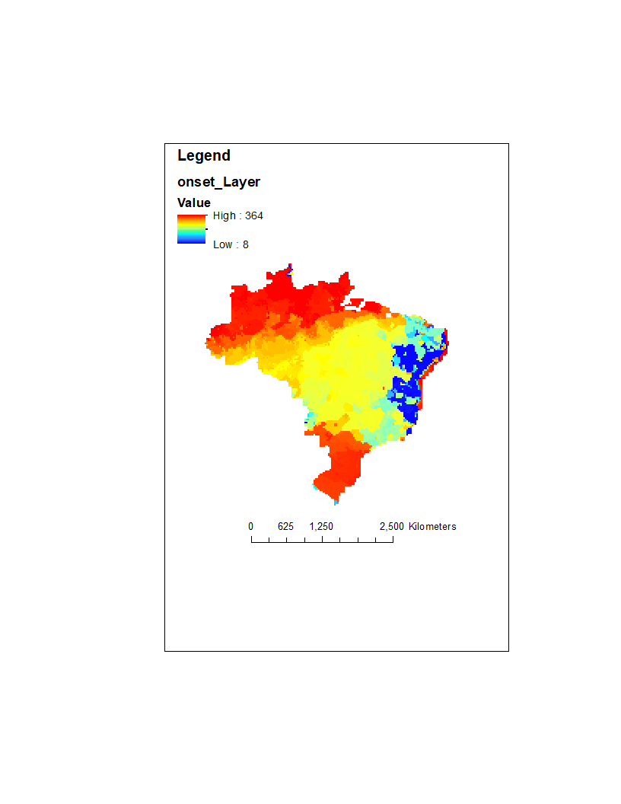
Exploratory data analysis to address challenges
Compare plots for early vs late wet season:
Plant date
Driver 1
Driver 2
Driver 3
Is planting date response linear?
At what spatial scales and temporal scales do unobserved effects become uniform?
Does irrigation make a difference?
Does start of wet season make a difference?
DOY of wet season onset

Slide 24
Exploratory data analysis to address challenges
Compare plots for large vs small properties:
Plant date
Driver 1
Driver 2
Driver 3
Is planting date response linear?
At what spatial scales and temporal scales do unobserved effects become uniform?
Does irrigation make a difference?
Does start of wet season make a difference?
Does property size make a difference?
Notes:
Is property size indicative of access to credit, to information like forecasts, and to access to machinery?

Slide 25
Exploratory data analysis to address challenges
2016
2015
2010
2005
Persistence of spatial trends over time:
The relative importance of time-invariant local characteristics and time-varying climate
Notes:
Other recommended EDA?

Slide 26
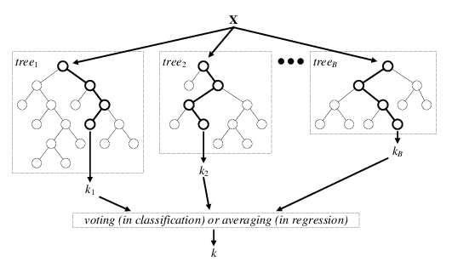
Explore model specifications
OLS regression
plant_{it} = X_{it}β + ε_{it}
Fixed effects regression
plant_{it} = α_{i} + X_{it}β + ε_{it}
Fixed effects (α_{i}) ‘absorb’ unobservable factors
Machine learning (random forest)
https://www.researchgate.net/figure/Architecture-of-the-random-forest-model_fig1_301638643
Notes:
Other model specifications?

Slide 27
Challenges for model specification
1. Unobservable controls on planting date
Access to agricultural credit
Availability of farm equipment
Soil type? Influence from neighbors? Agricultural extensions?
2. Relationships depend on planting time
September planting date = f(September rainfall)
November planting date = f(September to November rainfall)
3. Nonlinearities in planting date response
Very dry and very wet months both cause delay in planting
While phytosanitary law applies, planting date is insensitive to other factors
Notes:
For climate variable in regression: how to cope with challenge #2? (assuming that our equation can’t contain anything that farmers can’t observe before planting date, and that we don’t want a regression that depends on knowledge of the planting date)
‘first window of favorable climate’ – but that’s a date…

Slide 28
EDA for OLS model
For a characteristic that matters, e.g. size, do we fit a separate slope on climate for each size category; use it as its own separate explanatory variable; or include an interaction term?
X | Space | Time | Insight | For each:
All, demeaned | All | All | Globally important explanatory variables | Select explanatory variables using forward or ‘reduction’ model selection. Test for nonlinearity: Residuals will show whether there are nonlinear relationships that weren’t captured. If so, use scatterplots to find the nonlinear relationship. Test for multicollinearity: take out one explanatory var at a time; if coeffs of the other vars change a lot, have multicollinearity issue – subset or take it out.
All, demeaned | Five major regions (based on political boundaries and ‘soy spots’) | All | Do the relevant explanatory variables (and their strengths) differ among regions? Do the ‘important’ vars change over space?
All, demeaned | 200km cells in each of the regions; 50km cells in each of the regions | All | Do the coefficients change when the spatial scale changes? Do the ‘important’ vars change over space? What is the appropriate spatial scale to minimize error but still give a reasonable set of equations?
All, except for trend | Five major regions | Groups of 3 years, individual years | Do relationships change over time? (are the coefficients significantly different?) do the ‘important’ vars change over space?

Slide 29
Outcome of EDA for OLS models:
Appropriate spatial scale of estimations
The explanatory variables to include at the chosen spatial scale
The need for a trend term or year dummies
Nonlinearities in explanatory variables

Slide 30
Each model addresses the challenges differently
OLS
Fixed effects
Random forest
No real solution; subset data by time and space to minimize the issue
Time and location fixed effects absorb confounding factors
No real solution; subset data by time and space to minimize the issue
Unobservable controls on planting date
Relationships depend on planting time
Handled in decision tree structure
Careful definition of climate variables, informed by exploratory data analysis
Nonlinearities in planting date response

Slide 31
Defining sensitivity of plant date to climate
Perturbation in climate
Model of planting date behavior
Change in planting date

